Slide 1

TIME TRACKER
STUDENTS: Anizio pereira | Leonardo ramalho | VITOR LATORRACA | Werner HANSEN
Programming fundamentals – java
PROFESSOR: Dr. Gurleen Kaur

Slide 2
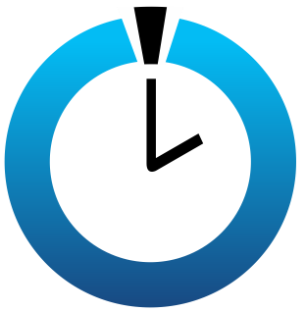
PROject details
TIME TRACKER CONCEPTS

Slide 3
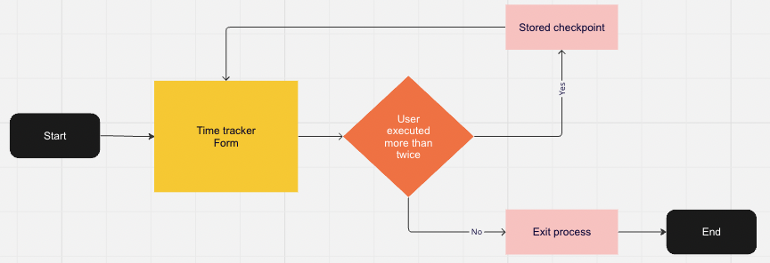
FLOW

Slide 4
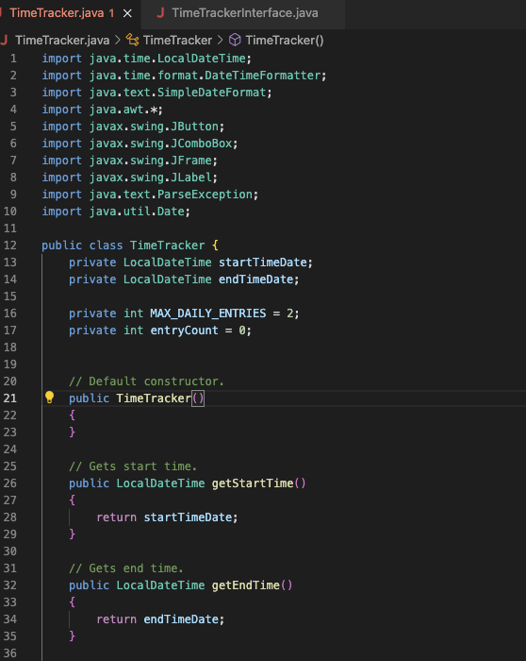
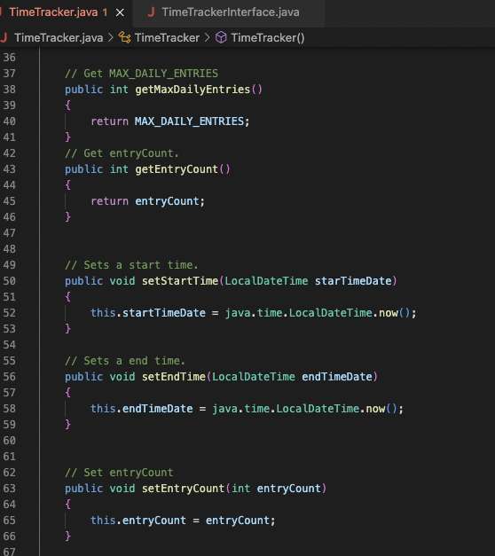
CODE – class base

Slide 5
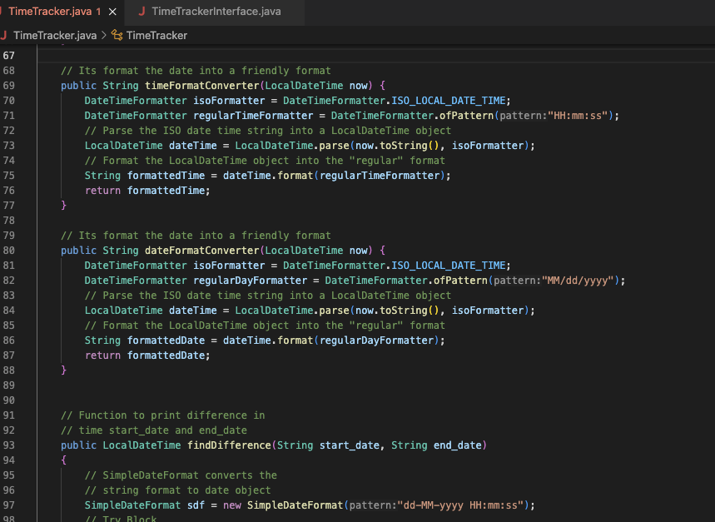
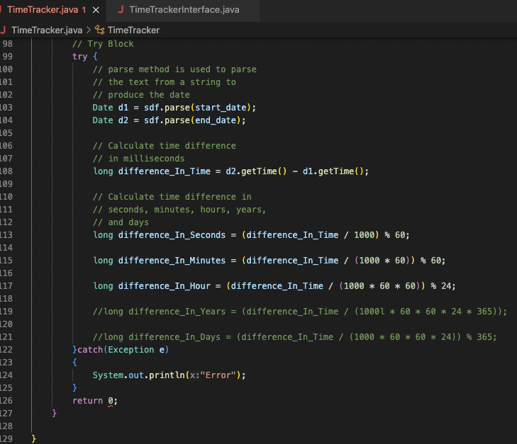
CODE – class base

Slide 6
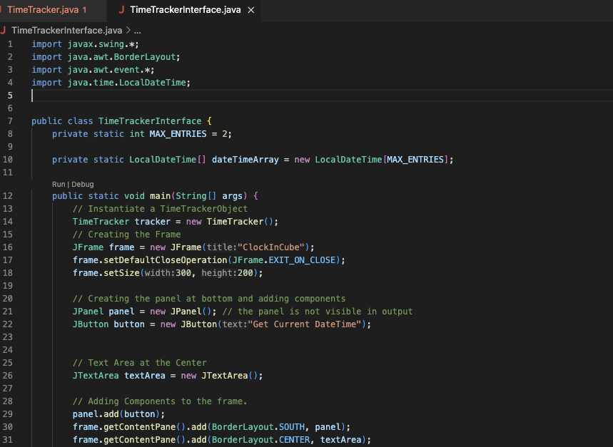
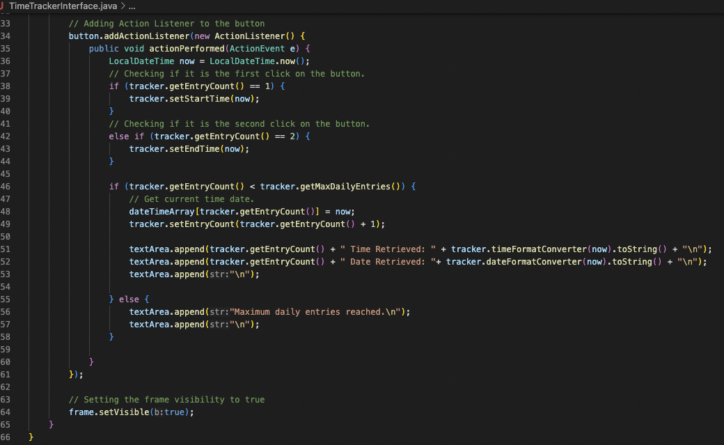

CODE – frontend

Slide 7
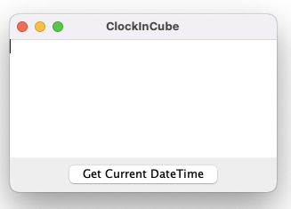
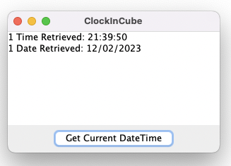
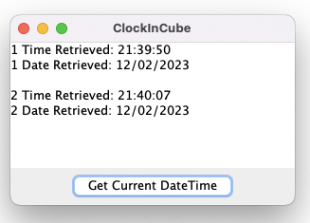
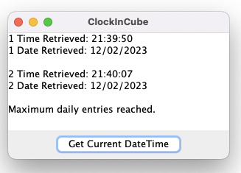

SCREEN DEMO

Slide 8
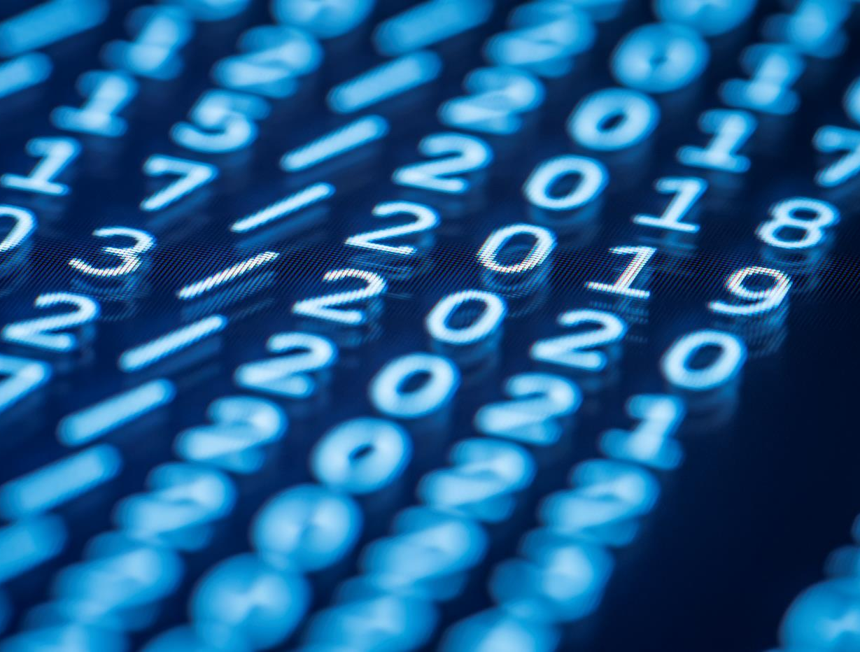
Thank you!

